Slide 1
Membership and Leadership Continuity
Britt Vaughan - MA, MPA

Slide 2
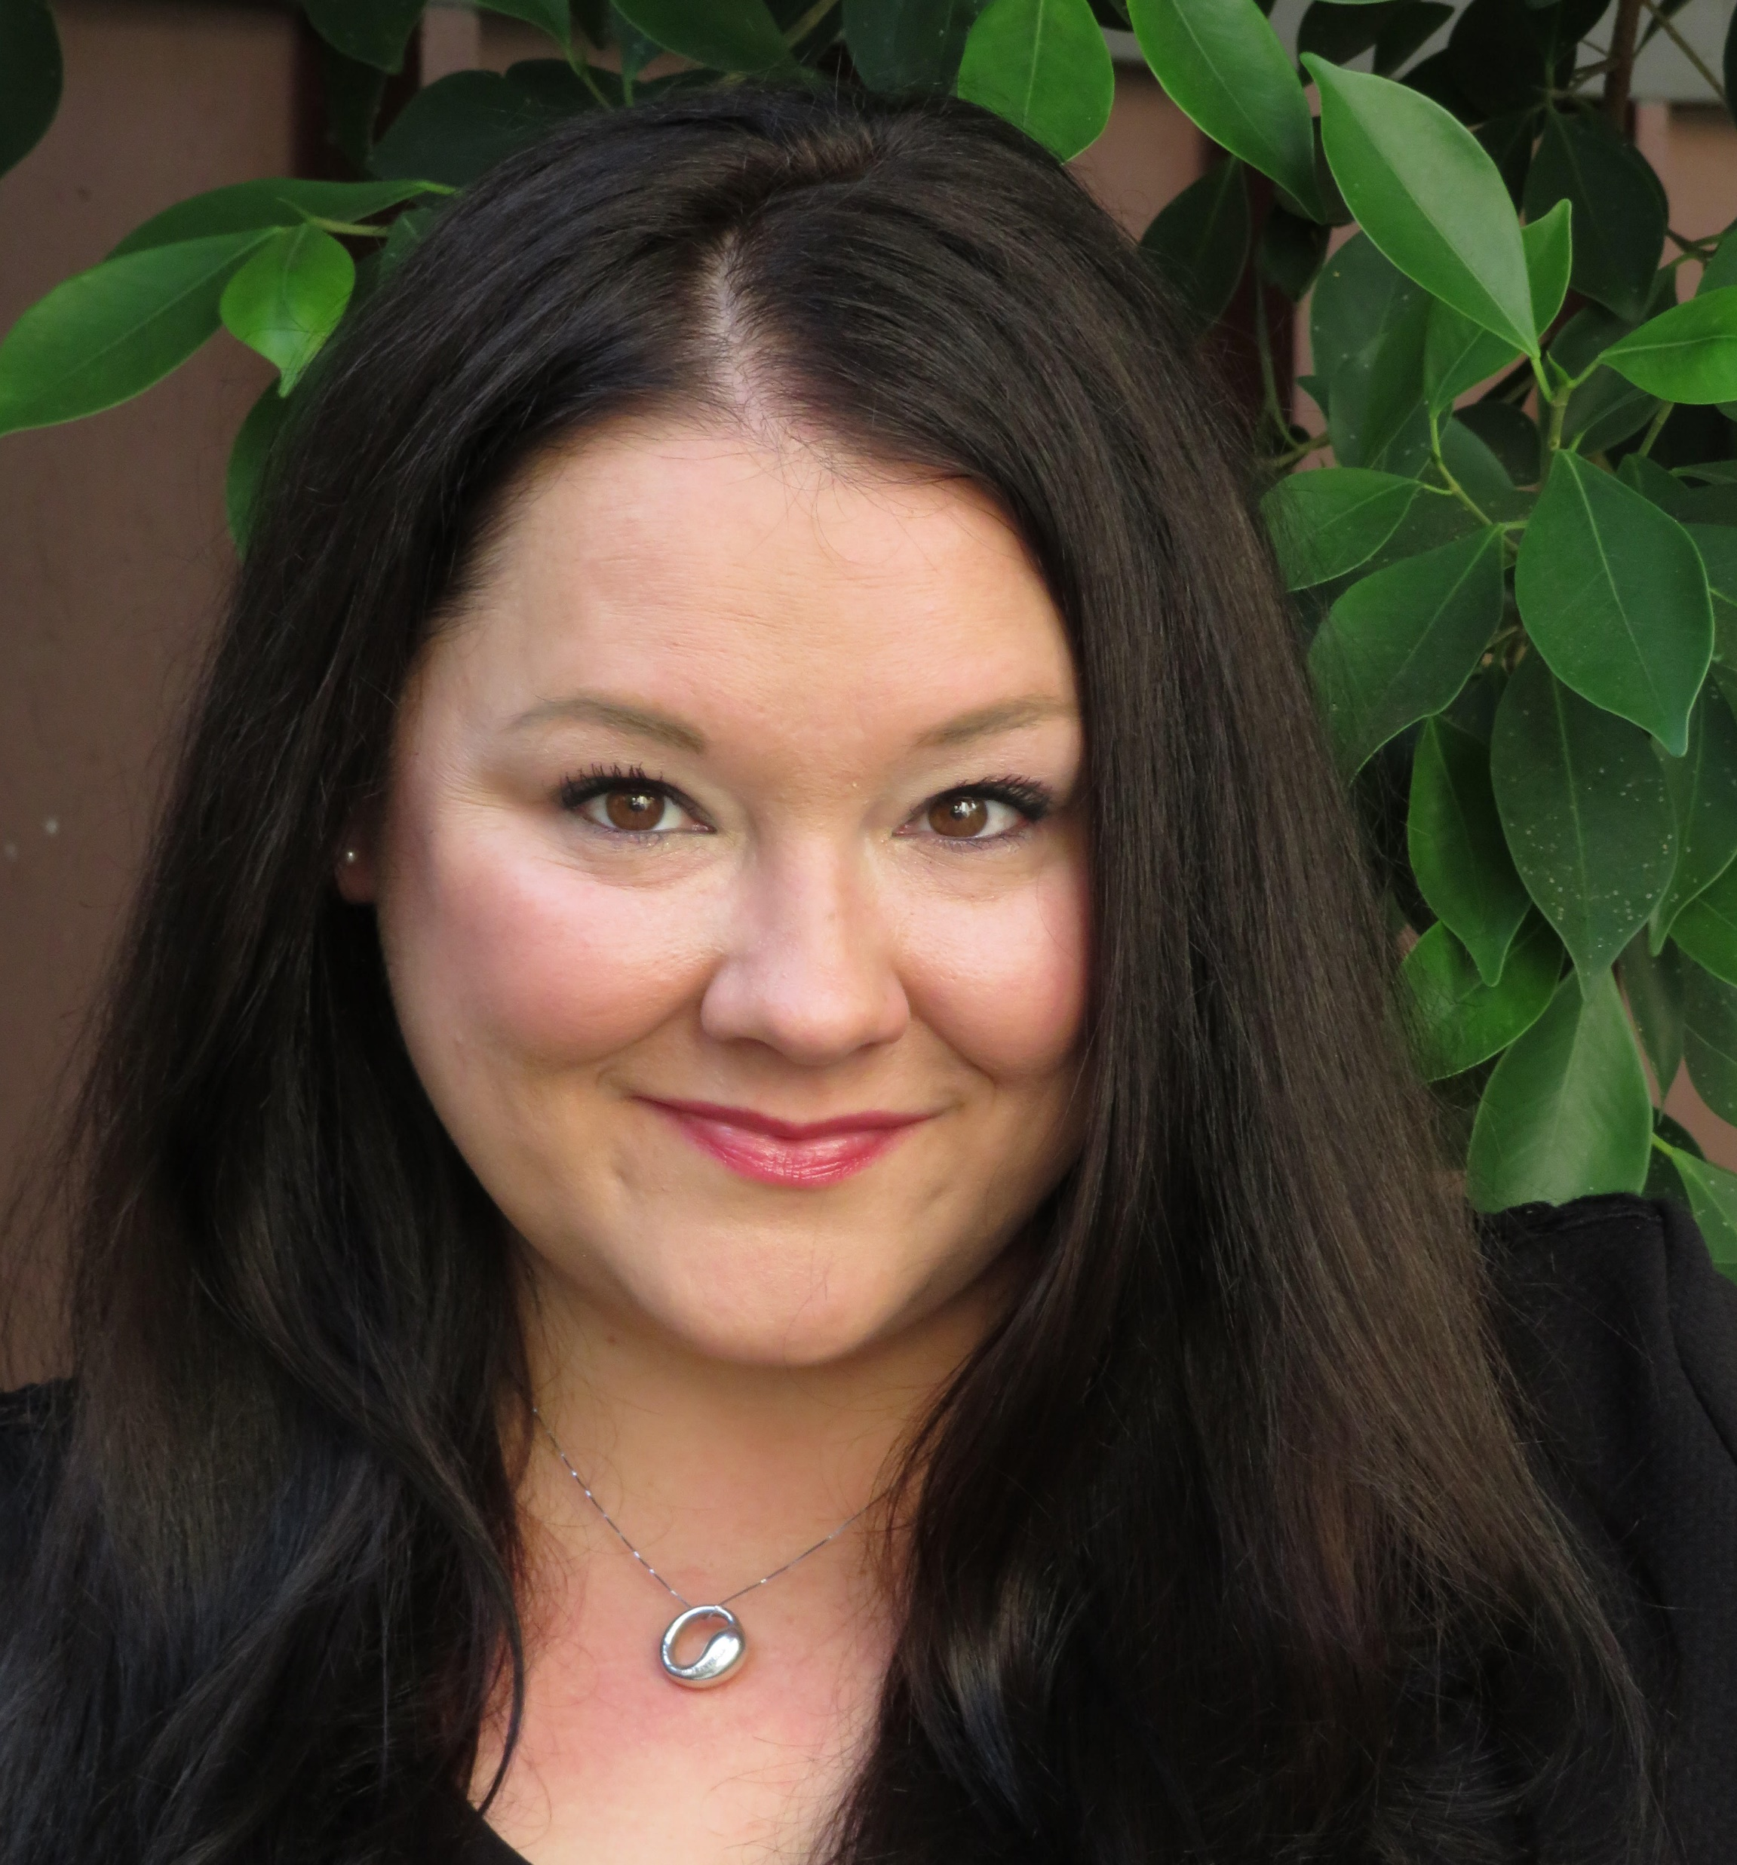
ABOUT ME
L.A. Native
Life-long Learner
Nonprofit Sector Professional
Volunteer
Avid Traveler

Slide 3
ABOUT YOU
How many are current presidents of your chapter?
How many of you felt you were well prepared to take on this position?
How many have engaged in leadership continuity or succession planning as part of your profession?
How many have engaged in it as part of your chapter?

Slide 4
SESSION OUTCOMES
1 | 2 | 3 | 4
Define and Value Leaderhip Continuity | Understand the relationship between leadership continuity and membership practices | Identify practical leadership continuity practices | Seek more knowledge on the topic
SUCCESS

Slide 5
TODAY’S BIG IDEA
There isn’t one
I’m probably not going to tell you anything you don’t already know but hopefully I’m going to inspire you to take some small actions that will make big differences.

Slide 6
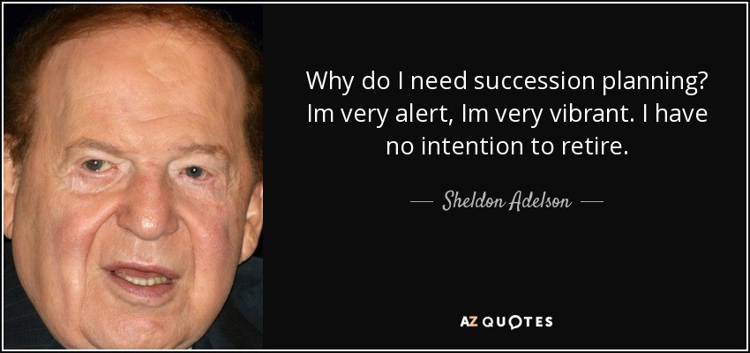

Slide 8
What is Leadership Continuity?
Defining Leadership Continuity
Leadership Continuity vs. Succession Planning

Slide 11
WHY THIS MATTERS
More than 74% of leaders report they are unprepared and lack the training for the challenges they face in their roles.
Only 35% of organizations have a formalized succession planning process for critical roles.
50% of leaders reported that it took them six months to become effective in their new roles.
https://aiirconsulting.com/resource/21-shocking-statistics-on-the-state-of-succession-planning/

Slide 12
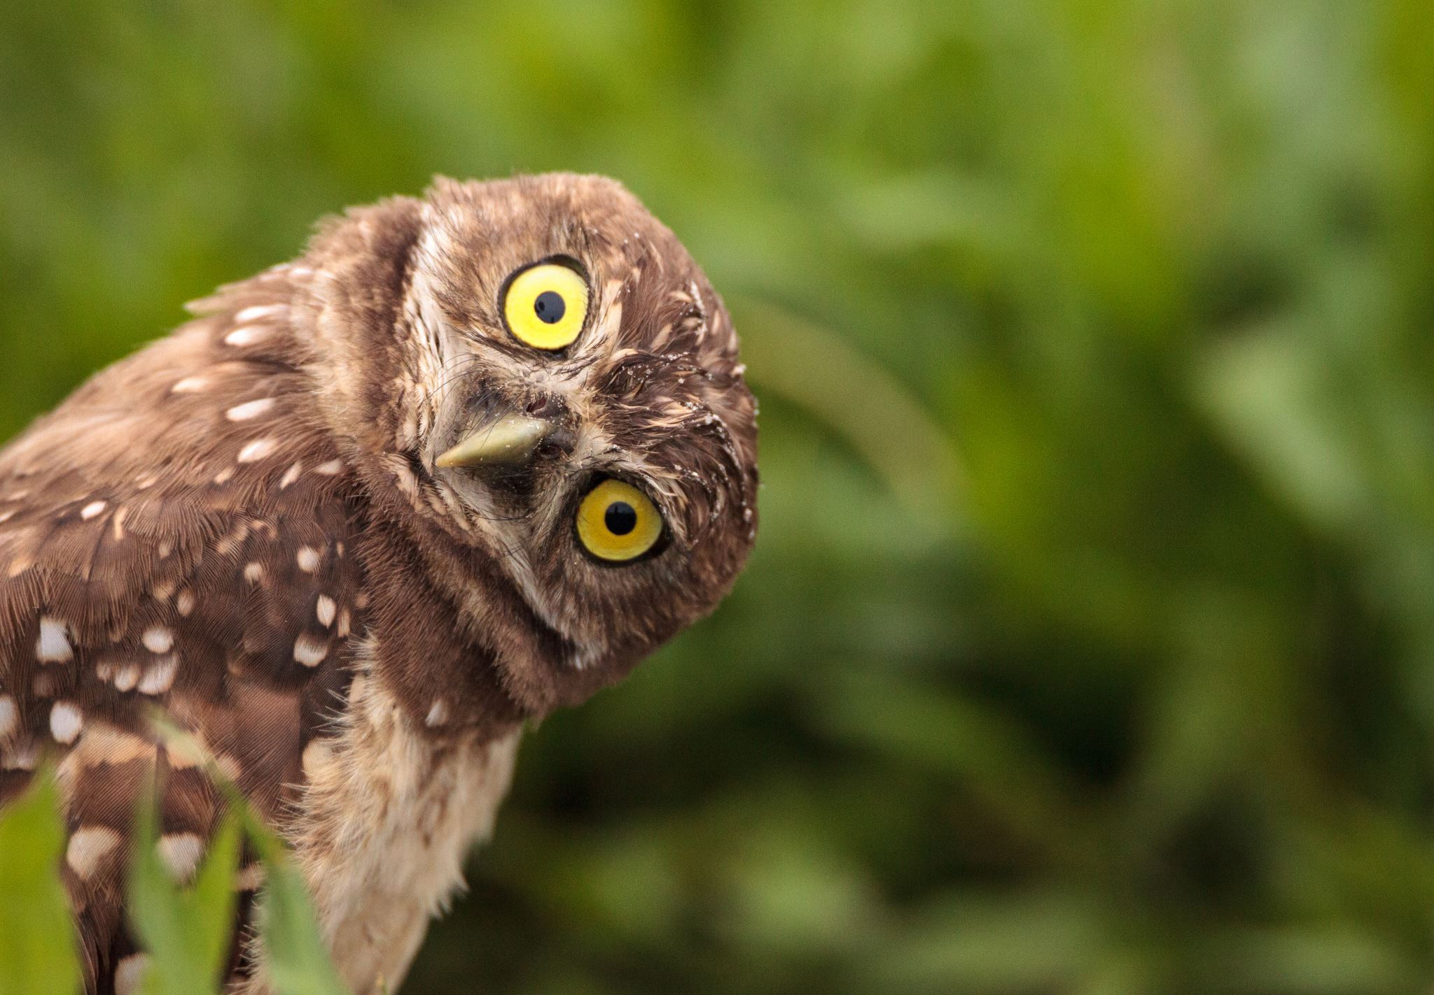
WHO IS RESPONSIBLE FOR LEADERSHIP CONTINUITY?

Slide 13
Building Continuity
Great Onboarding and Training
Clear Pathways and Expectations
Business Continuity Practices
Trusted Advisors and Mentors
Having a plan (and a plan B and a plan C)
Inclusive practices and transparency at every level

Slide 14
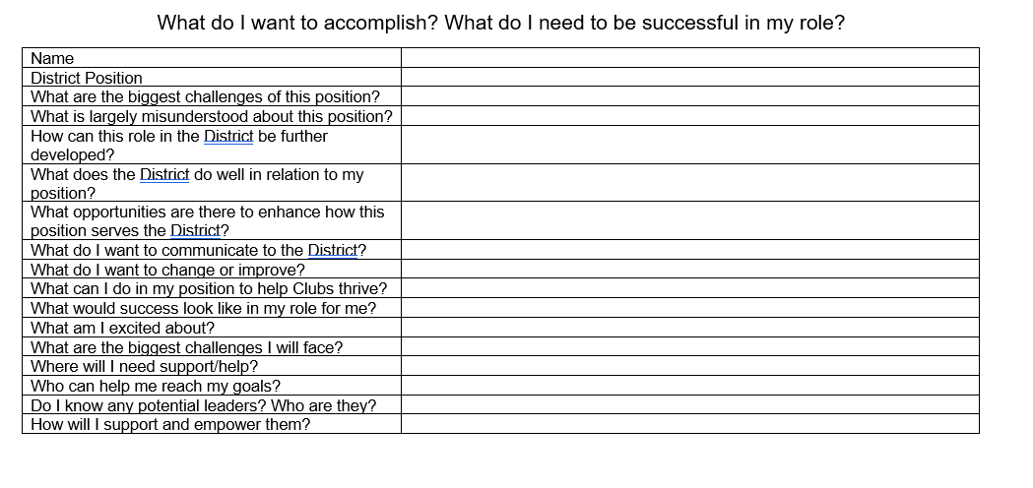
EXAMPLES OF LEADERSHIP DEVELOPMENT TOOLS

Slide 15
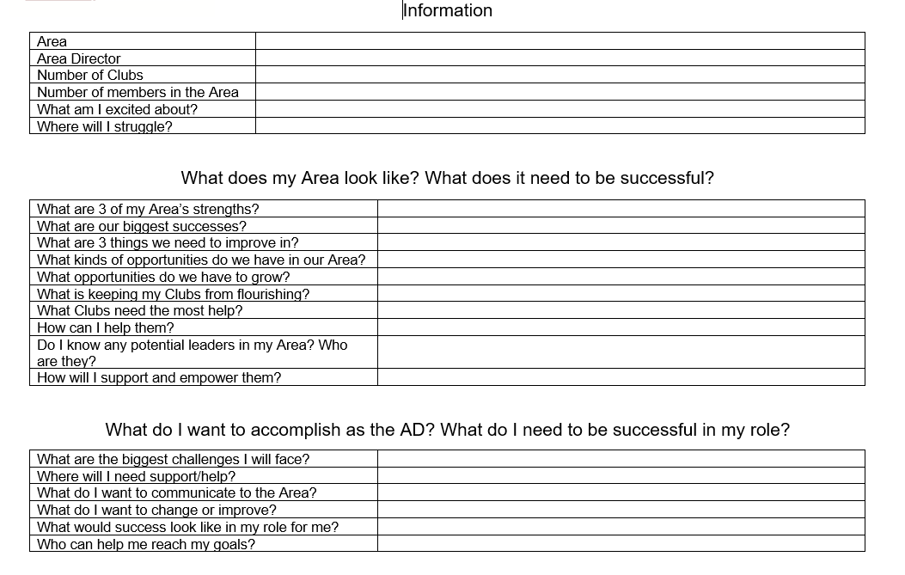
EXAMPLES OF LEADERSHIP DEVELOPMENT TOOLS

Slide 16
WHAT DO THESE TOOLS SHOW US?

Slide 17
WHAT’S THE PLAN?
It’s exactly what you think… but there are some nuances
Right people on the right seat on the bus (Good to Great)
- Are they a SME? A Thought Leader? A Strategic Leader?
Rockstars vs. Superstars (Radical Candor)
- Are their skills somewhere else?

Slide 18
Failure to Plan
What are some assumptions we make about this process?
How do we plan for the unforeseen?
What happens if we do nothing?

Slide 19
LEADERSHIP CONTINUITY AND MEMBERSHIP
What are some membership best practices your chapter utilizes for retention?
How do these relate to leadership continuity?
What does membership recruitment have to do with it?
Where is there room for growth?
These concepts are INTERSECTIONAL!

Slide 20
HOW ARE WE EMPOWERING PEOPLE TO STEP UP?

Slide 21
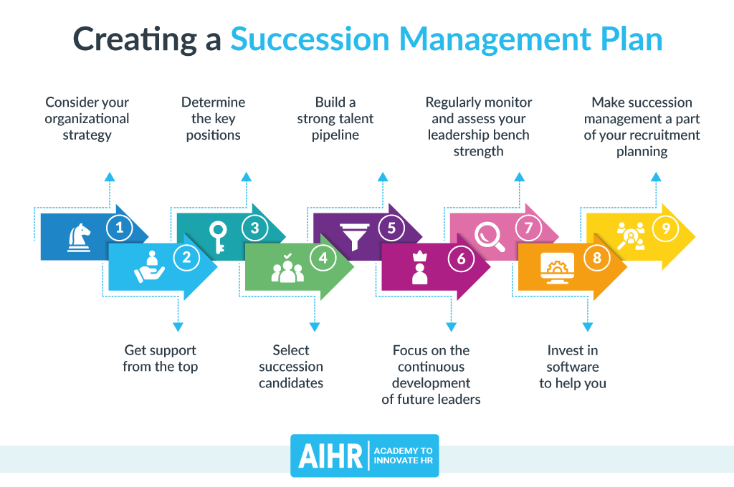
EXAMPLE

Slide 22
FURTHER LEARNING
1 | 2 | 3 | 4
Good to Great (book) | Radical Candor (book) | Nonprofit Ready (online) | Lollipop Moments (TED talk excerpt)

Slide 23
QUESTIONS

Slide 24
THANK YOU!
Britt Vaughan
BrittVaughan@outlook.com

