Slide 1

INTERACTIVE BOOK FESTIVALS
Presented by Susan Long and Mindy Hellmich

Slide 2


Interactive Book Festival – 5 Components
Storybook Character Parade
Puppet Show
Classroom Readers
Library Reading Buddies
Author Chat

Slide 3
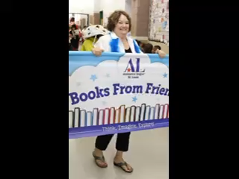
Storybook Character Parade
Everyone loves a parade…..

Slide 4
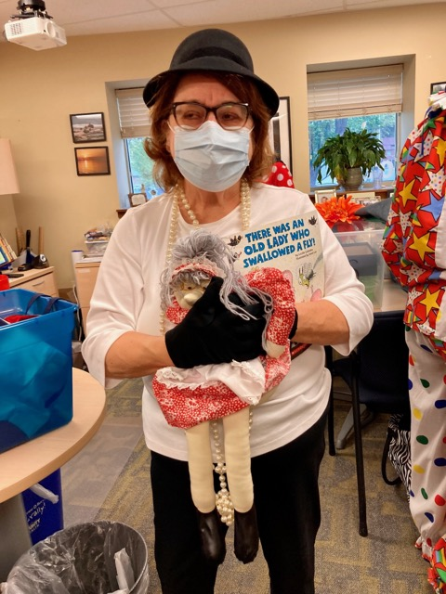
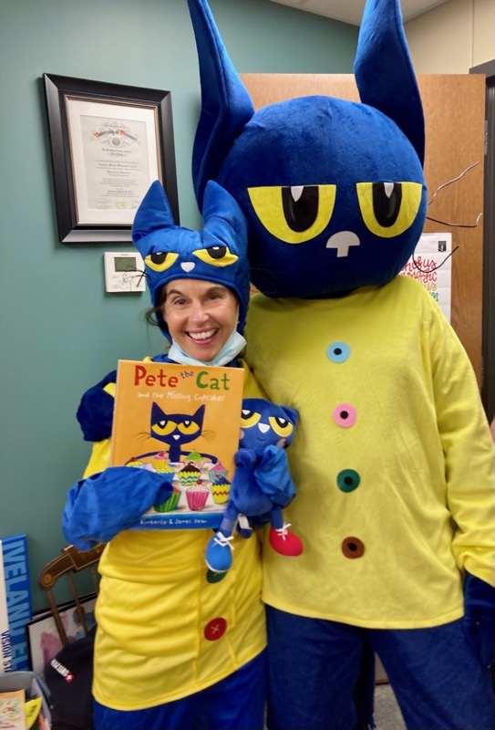
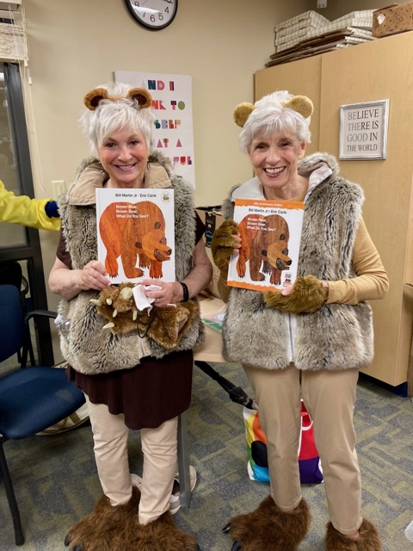
Storybook Character Parade

Slide 5
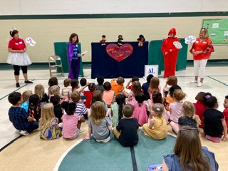

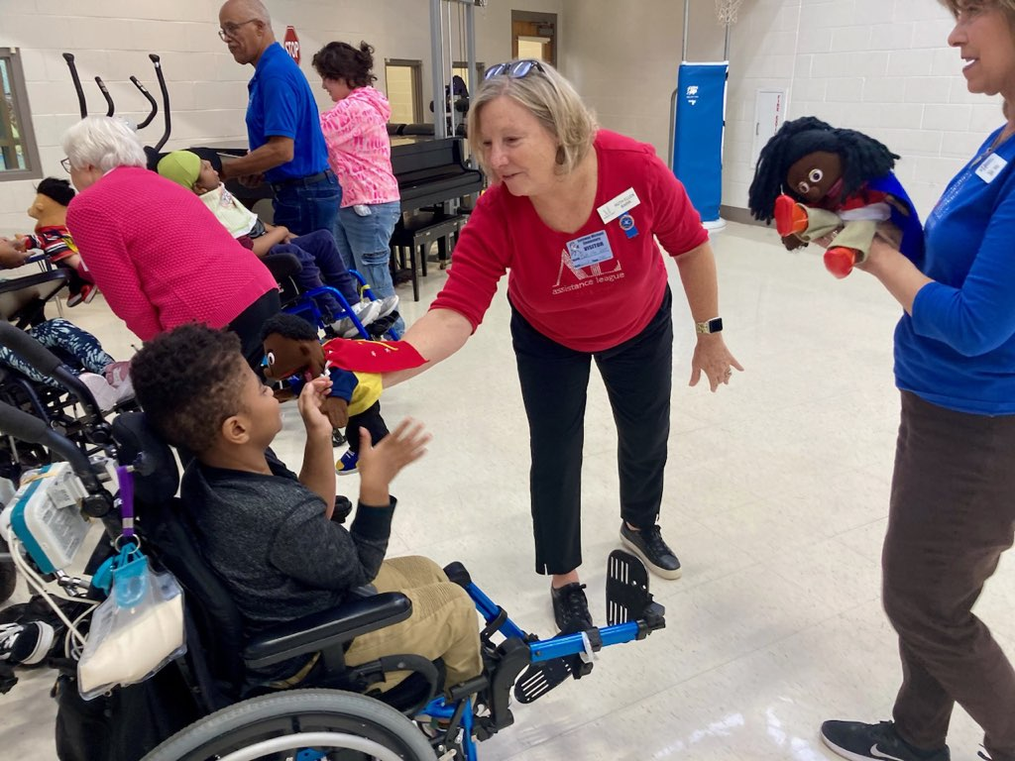
Puppet Show
The puppet show encourages children to listen, learn, and chant along.

Slide 6
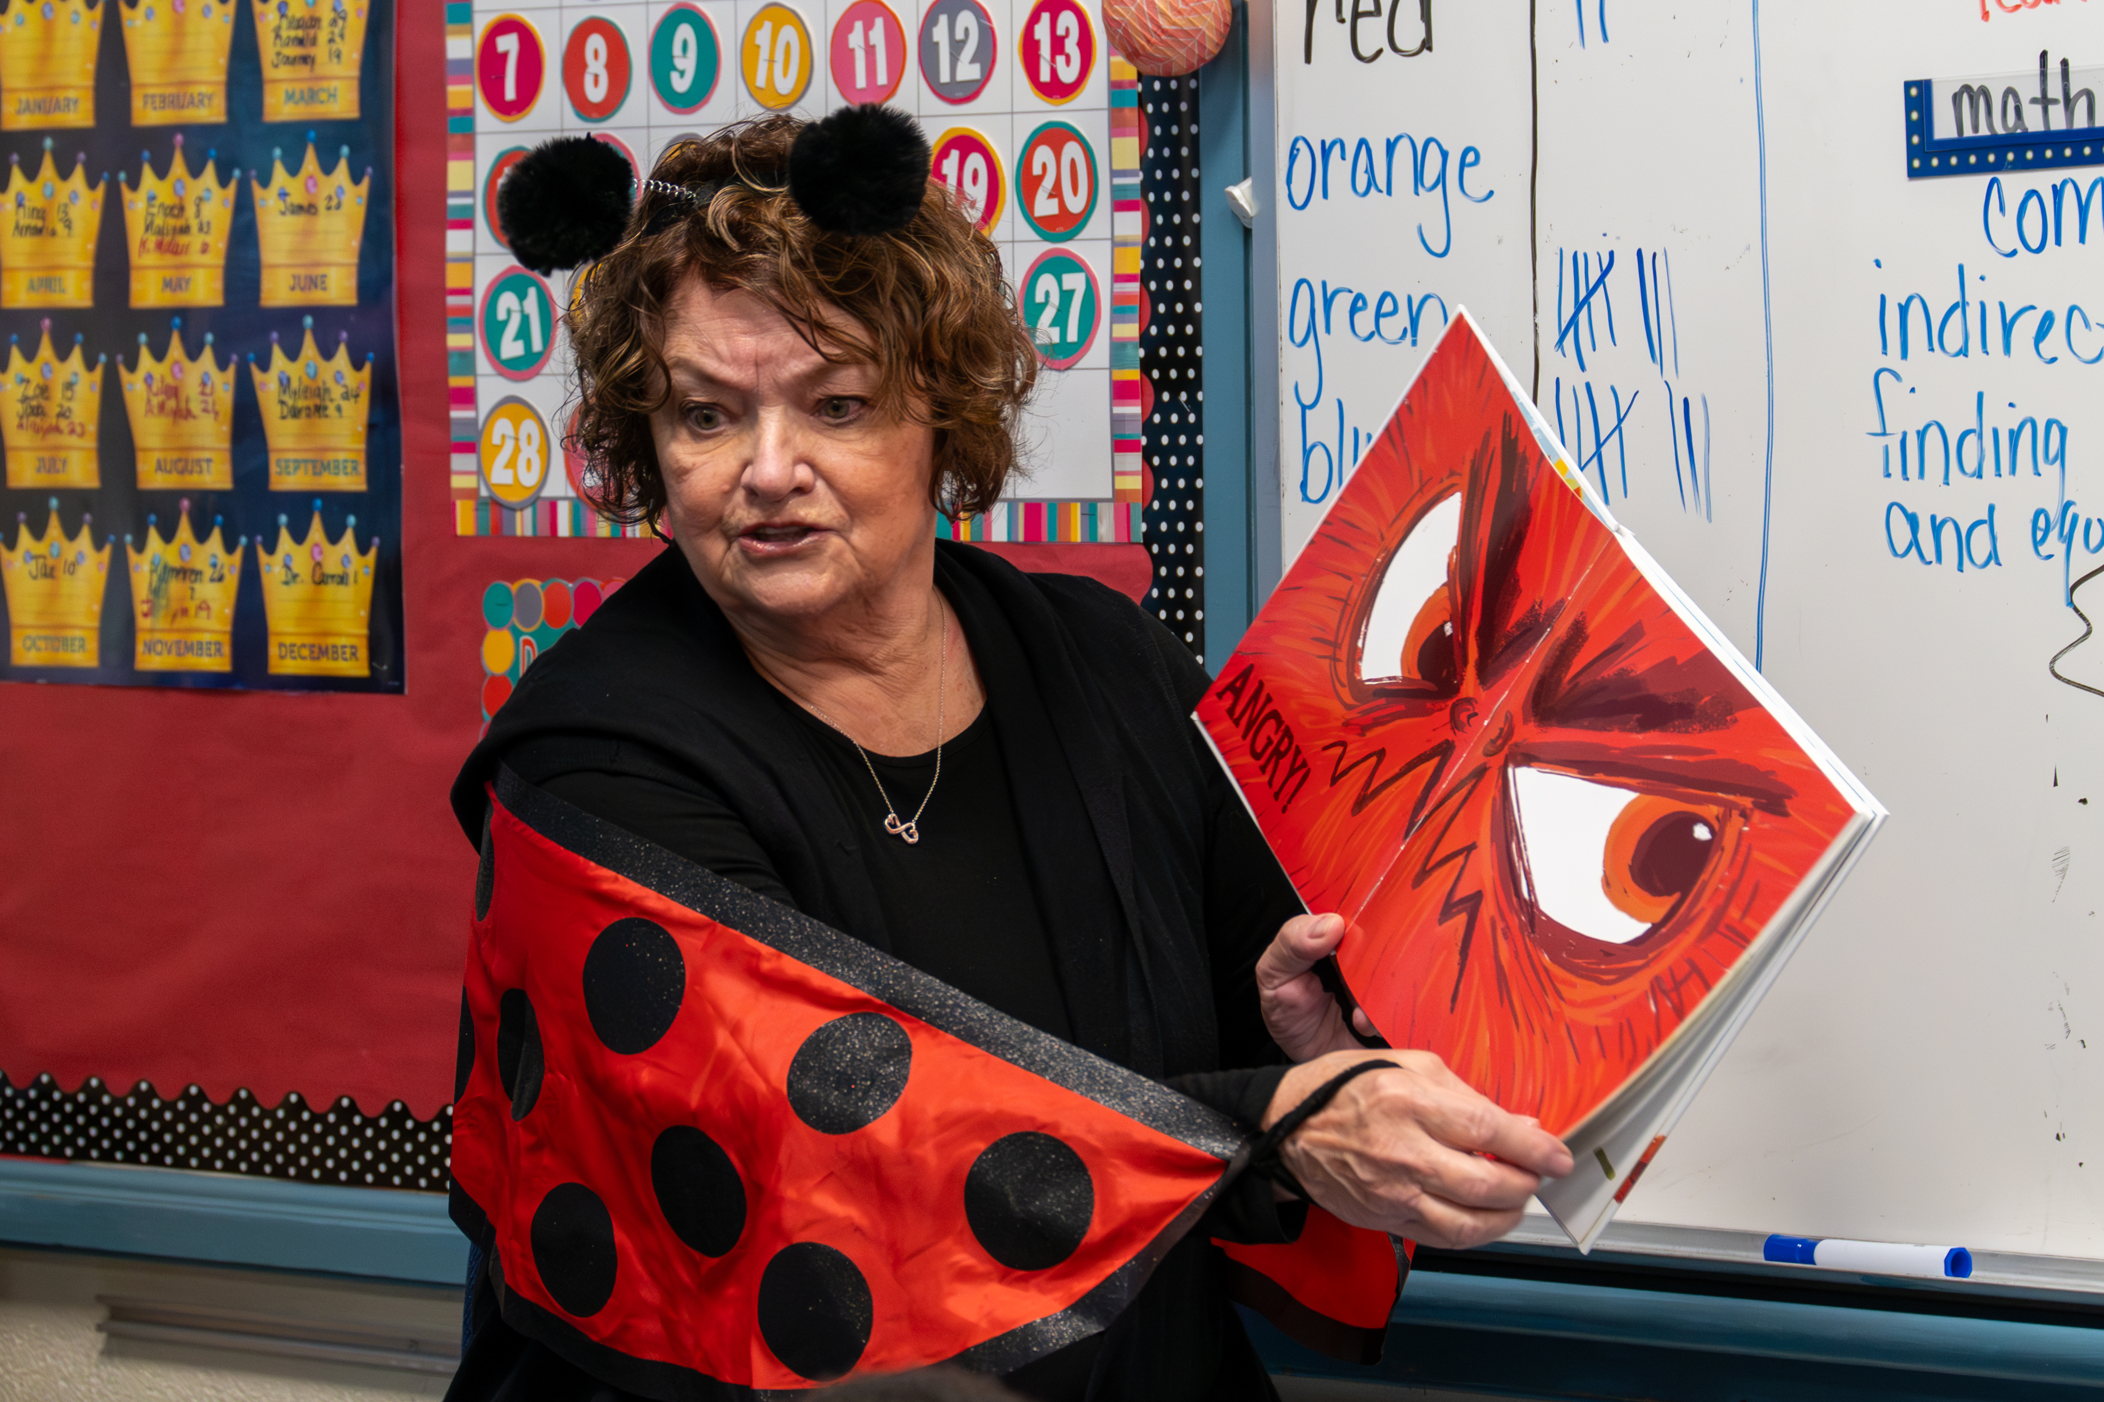
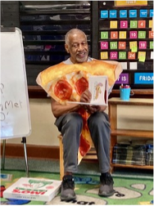
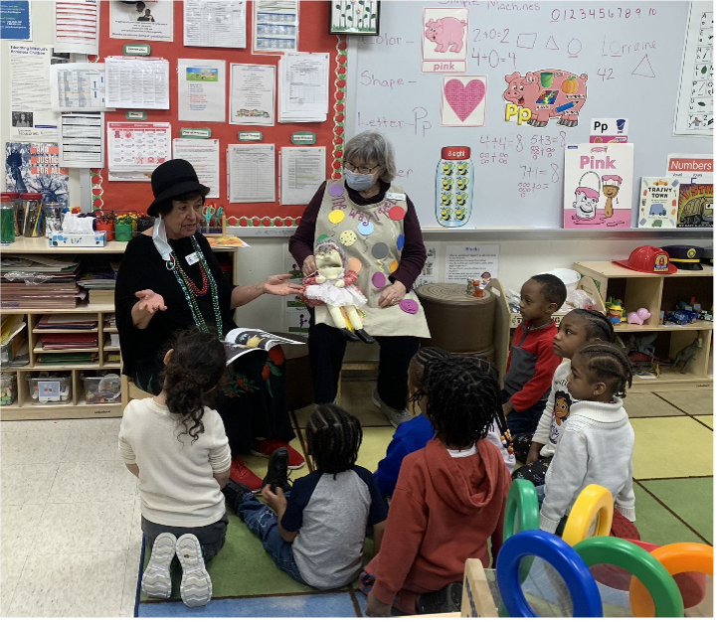
Classroom Readers

Slide 7
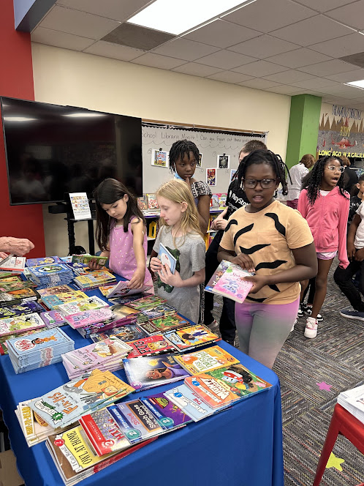
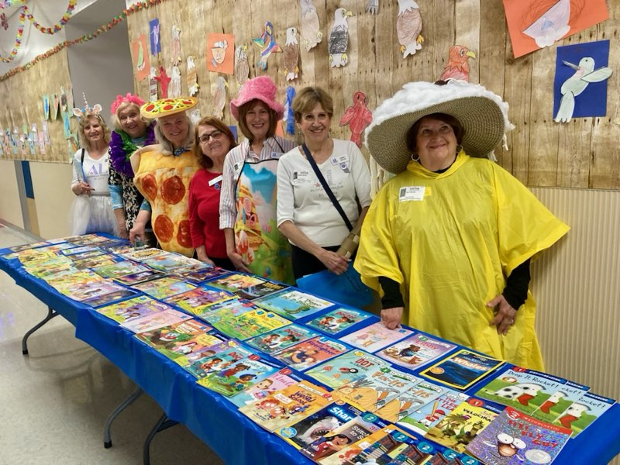
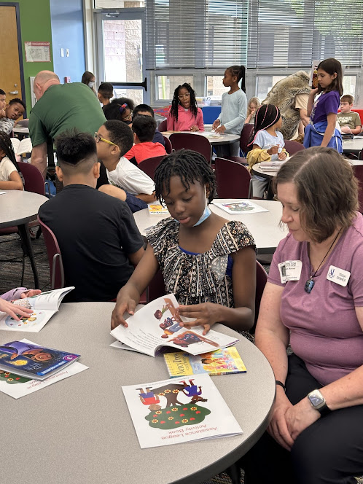
Library Reading Buddies

Slide 8
At the end of the day, every child goes home with two new books. Some of these children have never had a new book of their very own to write their name in, and to keep for their own personal home library.

Slide 9
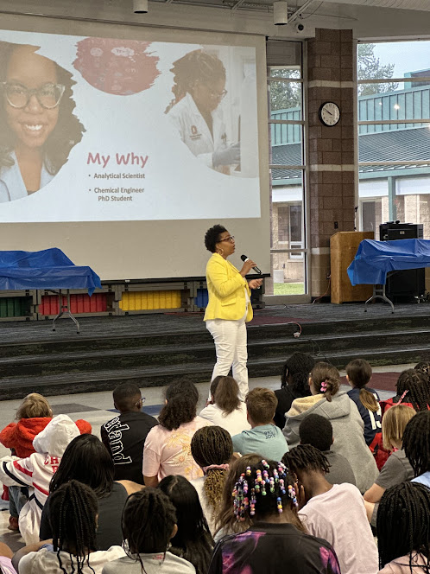
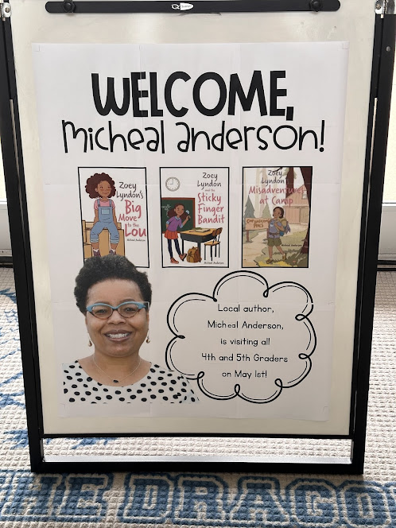
Author Chat
Children have the opportunity to listen and learn from an awarding winning, local author Micheal Anderson.

Slide 10

Assistance League of St. Louis
Customized Books

Slide 11



Slide 12
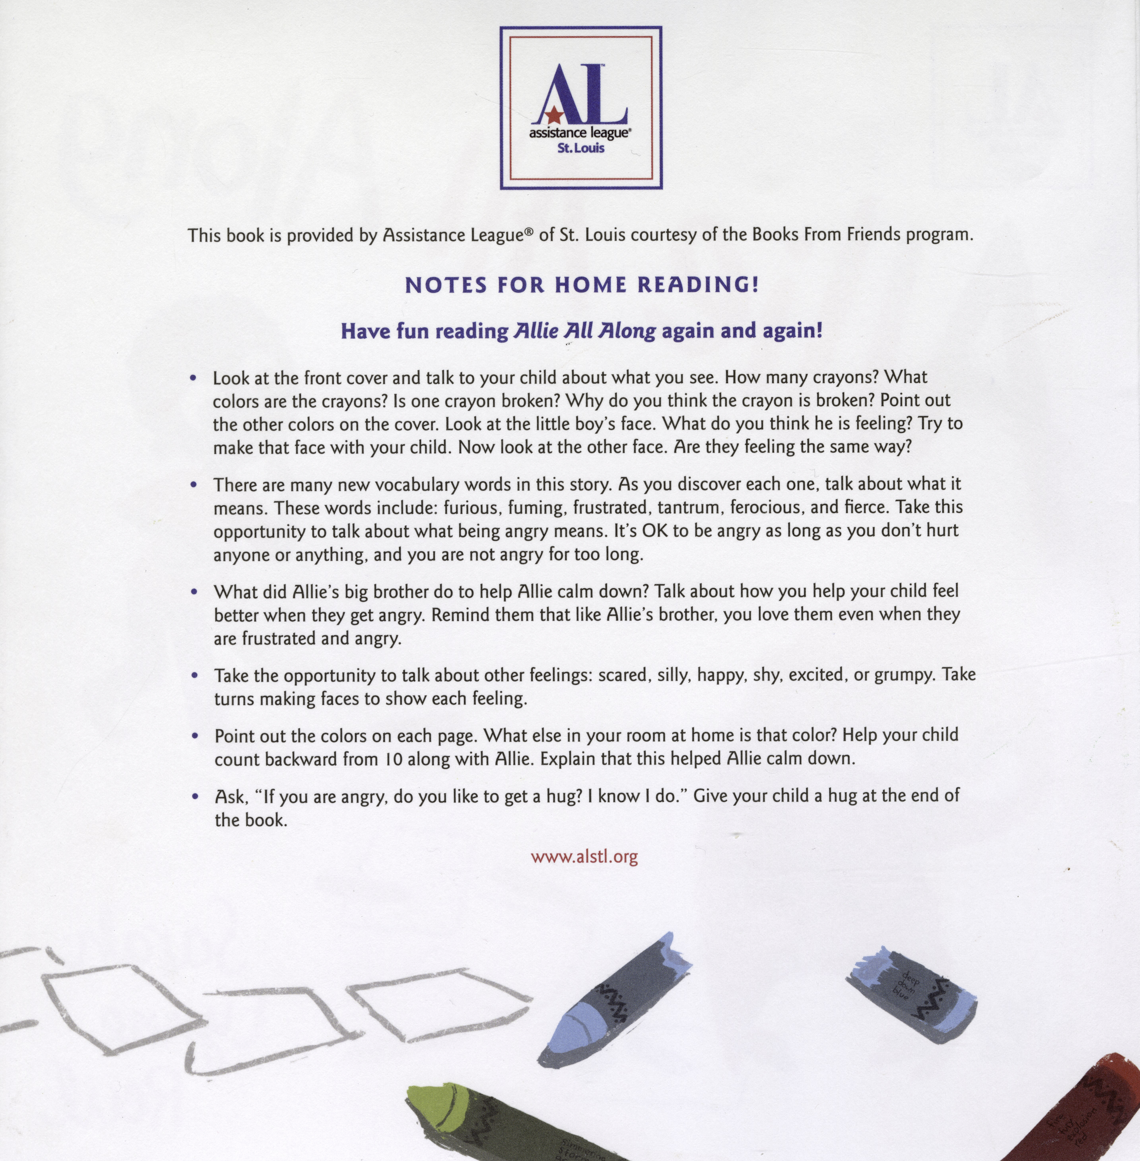

Slide 13
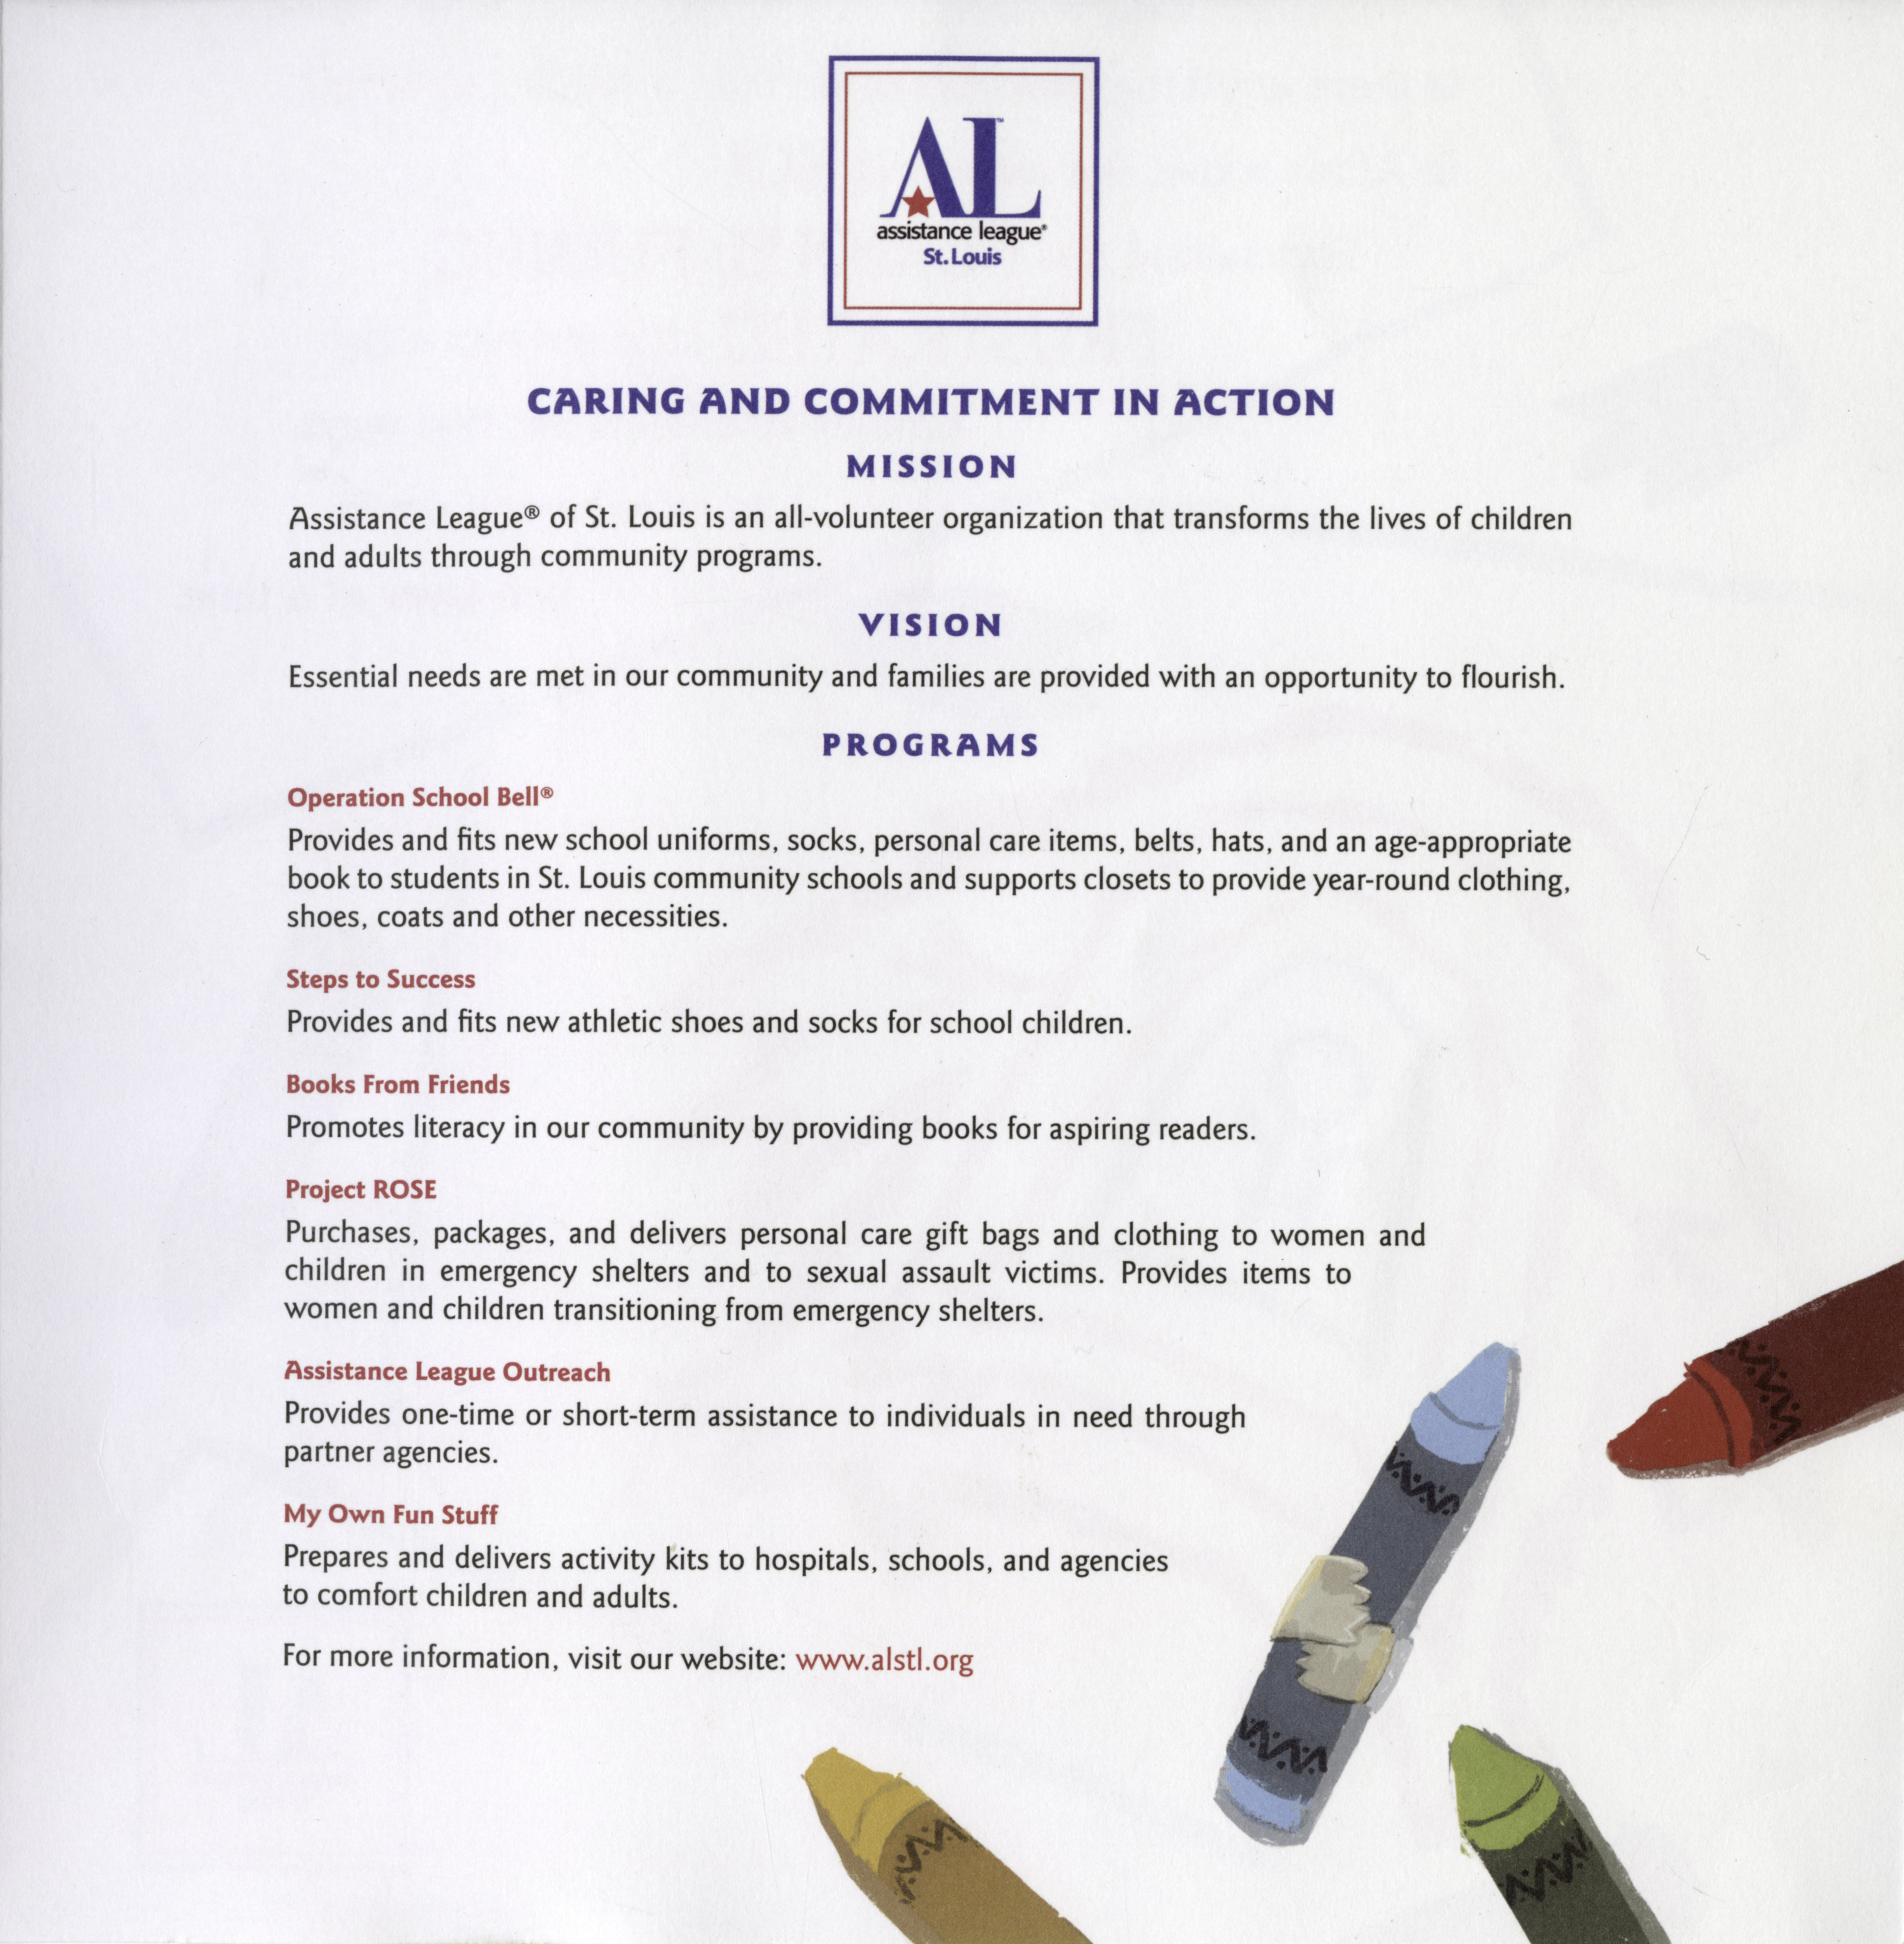

Slide 16
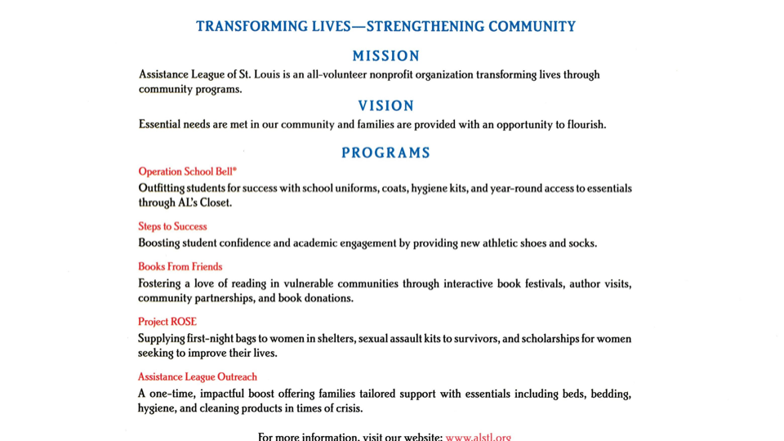

Slide 17
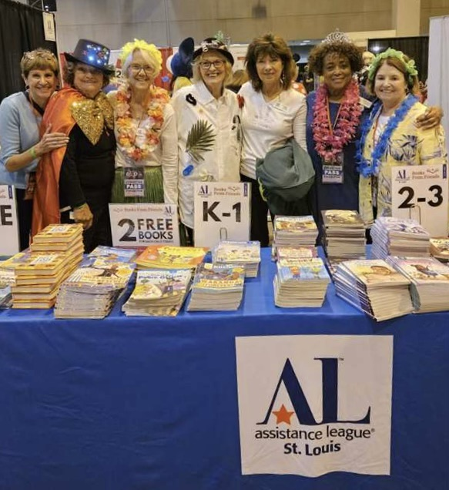
URBAN LEAGUE COLLABORATION

Slide 18
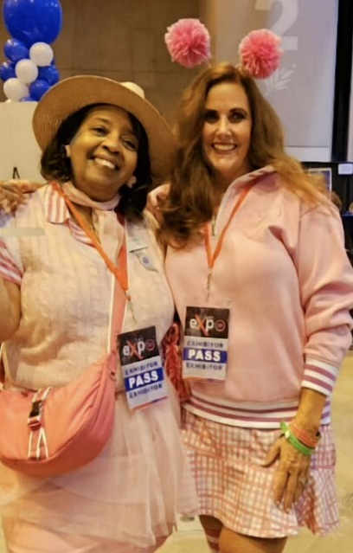
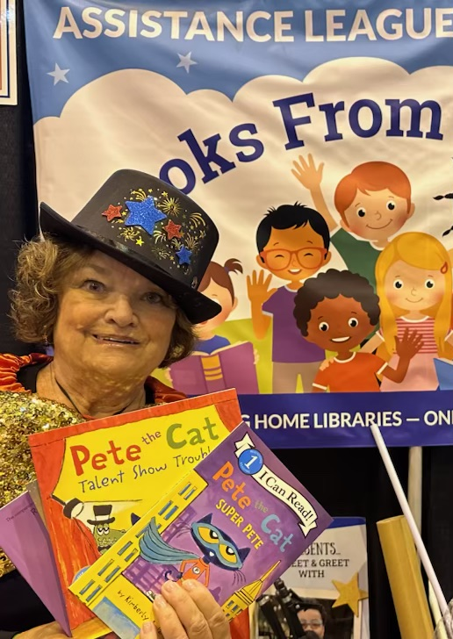
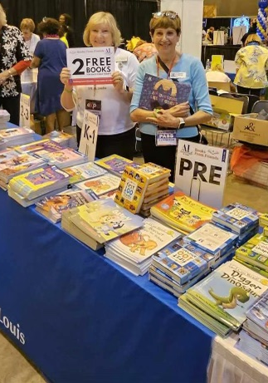

Slide 19
We would love to answer any questions you may have at this time.
Feel free to contact us with any questions in the future. Our email address is: booksfromfriends@stlouisassistanceleague.org
Q & A

